Slide 1
Lunch and Learn Microsoft OneNote
Celine Li and Kevin Liu
August 26，2019
Notes:
Introduce ourselves

Slide 2


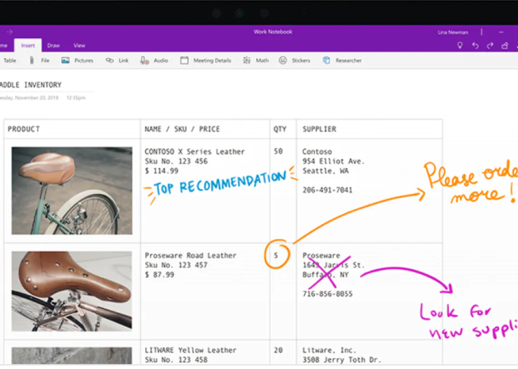
Background
A digital notebook for gathering and organizing information
User Friendly and Intuitive
Open OneNote and follow along in this tutorial
Convenient
Automatically syncs your digital notebook as you are editing so you can view and edit your notes from any device
Never have to click “Save”
Access your notebook anywhere
Use any device to log onto one-note.com (sign in with your Microsoft account) and you can view/edit the synchronized notebook from anywhere

Slide 3
Hierarchy and Layout
Top Level: Notebook
Default notebook is yourname@work e.g. Celine@Work, Kevin@Work
Add as many notebooks as you like
Organized notebooks by courses when I was a student
Second Level: Sections
Example: “To do list” “Meetings Notes” “Articles”
Fourth Level: Tabs
Example: Home, Insert
Different groups of functionality
Third Level: Pages
Example: Different days/weeks in the “To do list” section
Automatically dated by when the page is added
Notes:
We will explore the various levels of the Onenote app
We’ll pull up a window on the side so you can follow along, then we’ll demonstrate how to create each level

Slide 4
Home Tab
Change Fonts
Add tags
- To do tag
- Important (star)
- Question mark tag
- Highlight an item
Emailing a page, or Share your notebook
Notes:
First tab that appear in the default page is “Home” Tab
There are 3 main features in the tab that we can use

Slide 5
Insert Tab
Insert File Printout
- Displays the file’s full content in the notebook
- Print to OneNote from Word, PDF, PPT, Excel, Etc.
Download different Page Templates
Insert Tables, Dates, Symbols and Equations
Insert Pictures / Online Videos /Screen Clips/ Hyperlinks (automatically dated with links)
Recorded Audio or Video

Slide 6
Draw Tab
Draw/mark up comments in a document or screen shot, and email the page to someone
- Example: Insert a printout attachment such as a PowerPoint, and draw your comments on the slides
- Example: Take a screenshot of something and draw comments
Ink to Text
Ink to Math
Choose to write something with your cursor or tablet pen
Select the writing or drawing and manipulate it

Slide 7
Three Very Helpful but Often Overlooked Tabs
History Tab
Find deleted notebooks or pages in recycle bin
Undo: Ctrl+Z or click the arrow on the top left corner
Review Tab
Check your spelling or use Thesaurus
View Tab
Change page colour, section colour, blank pages to grid pages, Etc.
Quick Note feature similar to Sticky Note

Slide 8
Other Great Features
Allows for collaboration through “Share” option
Integrate OneNote to Outlook meeting invites
From an email, Ctrl+Alt+R to create a meeting with everyone in the email
Click on the “OneNote” icon in the meeting invite to share meeting minutes with everyone
Search your notebook for keywords
If you don’t remember which page/section the information is at
Password protect a section
The content of the section reveals only after you enter the password
Turn off Auto Sync through “Sync Status” or “Options”

Slide 9
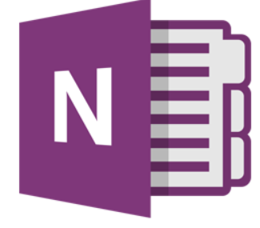
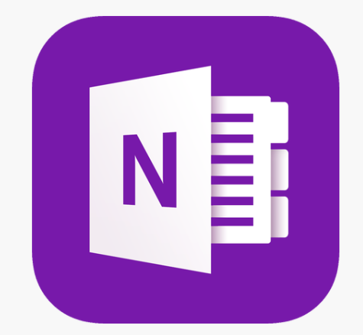
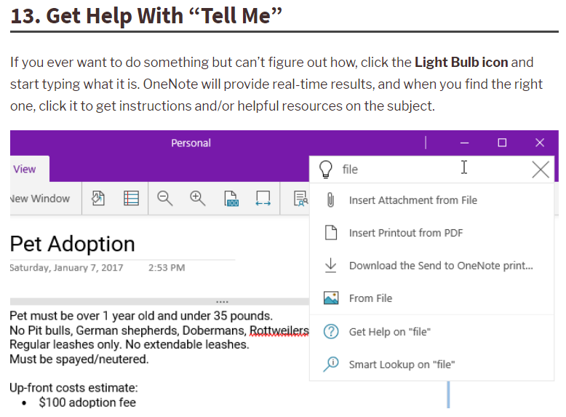
Features in the Windows 10 Version
Windows 7 version icon and Windows 10 version icon
Dictate your notes
Light bulb icon “Tell Me” feature for how to do something in OneNote

Slide 10

Questions?
Notes:
Feel free to ask us if there’s any questions

